Slide 1
Full Stack Web Development
Memcached / Getting Started

Slide 2
What Is Memcached?
Free & open source, high performance, distributed memory object caching system, generic in nature, but intended for use in speeding up dynamic web applications by alleviating database loads
Key-value store for small chunks of arbitrary data (strings, objects) from results of db calls, API calls or page rendering
Similar to Redis without the data persistence

Slide 3
Advantages of Memcached
Simple yet powerful – promotes quick design and development
Solves many problems that face large scale data caches
API is available for most popular languages
Uses a distributed system – Clusters of servers accessing the same cache

Slide 4
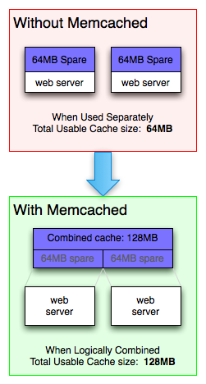
Optimizing Memory
Memcached allows you to take memory from parts of a system where you have more than enough and make it available to areas where you have less than you need

Slide 5
Who Uses Memcached?
LiveJournal – Created by Brad Fitzpatrick in 2003
Twitter
Wikipedia
Facebook
YouTube
Wordpress.com
Craigslist
Flickr
The list goes on and on…

Slide 6
Accessing Memcached
Telnet
libmemcached-tools (User space tools)
Clients For Many Languages
Python
PHP
Pearl
C++
Ruby / Rails
…

Slide 7
Gets & Sets
Telnet:
set username 0 3600 4
Brad
Python:
mc.set(‘username’, ‘brad’)
PHP:
$mc->set(‘username’, ‘brad’);
Telnet:
get username
Python:
mc.get(‘username’
PHP:
$mc->get(‘username’

Slide 8
Other Common Commands
add
delete
replace
append
prepend
incr
decr
flush_all
stats

Slide 9


